Slide 1
Chapter 24 - Introduction to Java Applications and Applets
Outline
24.1 Introduction
24.2 Basics of a Typical Java Environment
24.3 General Notes about Java and This Book
24.4 A Simple Program: Printing a Line of Text
24.5 Another Java Application: Adding Integers
24.6 Sample Applets from the Java 2 Software
Development Kit
24.7 A Simple Java Applet: Drawing a String
24.8 Two More Simple Applets: Drawing Strings and Lines
24.9 Another Java Applet: Adding Integers

Slide 2
Objectives
In this chapter, you will learn:
  To be able to write simple Java applications.
  To be able to use input and output statements.
  To observe some of Java’s exciting capabilities through several demonstration applets provided with the Java 2 Software Development Kit.
  To understand the difference between an applet and an application.
  To be able to write simple Java applets.
  To be able to write simple Hypertext Markup Language (HTML) files to load an applet into the appletviewer or a World Wide Web browser.

Slide 3
24.1 Introduction
Java
  Powerful, object-oriented language
  Fun to use for beginners, appropriate for experience programmers
  Language of choice for Internet and network communications
In the Java chapters, we discuss
  Graphics (and graphical user interfaces [GUI] )
  Multimedia
  Event-driven programming
  Free implementation at http://java.sun.com

Slide 4
24.2 Basics of a Typical Java Environment
Java Systems
  Consist of environment, language, Java Applications Programming Interface (API), Class libraries
Java programs have five phases
  Edit
    Use an editor to type Java program
    vi or emacs, notepad, Jbuilder, Visual J++
    .java extension
  Compile
    Translates program into bytecodes, understood by Java interpreter
    javac command: javac myProgram.java
    Creates .class file, containing bytecodes (myProgram.class)

Slide 5
24.2 Basics of a Typical Java Environment (II)
Java programs have five phases (continued)
  Loading
    Class loader transfers .class file into memory
      Applications - run on user's machine
      Applets - loaded into Web browser, temporary
    Classes loaded and executed by interpreter with java command
    java Welcome
    HTML documents can refer to Java Applets, which are loaded into web browsers. To load,
    appletviewer Welcome.html
      appletviewer is a minimal browser, can only interpret applets

Slide 6
24.2 Basics of a Typical Java Environment (II)
Java programs have five phases (continued)
  Verify
    Bytecode verifier makes sure bytecodes are valid and do not violate security
    Java must be secure - Java programs transferred over networks, possible to damage files (viruses)
  Execute
    Computer (controlled by CPU) interprets program one bytecode at a time
    Performs actions specified in program
  Program may not work on first try
    Make changes in edit phase and repeat

Slide 7
Editor
Program is created in
the editor and stored
on disk.
Phase 1
Disk
Disk
Compiler creates
bytecodes and stores
them on disk.
Phase 2
Compiler
Primary
Memory
Phase 3
Class Loader
Class loader puts
bytecodes in memory.
Disk
.
.
.
.
.
.
Primary
Memory
Phase 4
Bytecode Verifier
Bytecode verifier
confirms that all
bytecodes are valid
and do not violate
Java’s security
restrictions.
.
.
.
.
.
.
Primary
Memory
Interpreter
Interpreter reads
bytecodes and
translates them into a
language that the
computer can
understand, possibly
storing data values as
the program executes.
Phase 5
.
.
.
.
.
.

Slide 8
24.3 General Notes about Java and This Book
Java
  Powerful language
  Programming
    Clarity - Keep it Simple
    Portability - Java portable, but it is an elusive goal
  Some details of Java not covered
    http://java.sun.com for documentation
  Performance
    Interpreted programs run slower than compiled ones
      Compiling has delayed execution, interpreting executes immediately
    Can compile Java programs into machine code
      Runs faster, comparable to C / C++

Slide 9
24.3 General Notes about Java and This Book (II)
Just-in-time compiler
  Midway between compiling and interpreting
    As interpreter runs, compiles code and executes it
    Not as efficient as full compilers
      Being developed for Java
  Integrated Development Environment (IDE)
    Tools to support software development
    Several Java IDE's are as powerful as C / C++ IDE's

Slide 10
24.4 A Simple Program: Printing a Line of Text
Application
  Program that runs using Java interpreter (discussed later)
  Comments
    Java uses C-style // (preferred by Java programmers)
    Can also use /* ... */
1 // Fig. 24.2: Welcome1.java
2 // A first program in Java
3
4 public class Welcome1 {
5 public static void main( String args[] )
6 {
7 System.out.println( "Welcome to Java Programming!" );
8 } // end main
9 } // end class Welcome1.java
Welcome to Java Programming!

Slide 11
24.4 A Simple Program: Printing a Line of Text (II)
public class Welcome1 {
  Begins class definition
  Every Java program has a user-defined class
  Use keyword (reserved word) class followed by ClassName
    Name format - MyClassName
    Identifier - letters, digits, underscores, dollar signs, does not begin with a digit, contains no spaces
    Java case sensitive
  public - For Chapters 24 and 25, every class will be public
    Later, discuss classes that are not (Chapter 26)
    Programmers initially learn by mimicking features. Explanations come later.
  When saving a file, class name must be part of file name
    Save file as Welcome1.java

Slide 12
24.4 A Simple Program: Printing a Line of Text (III)
Braces
  Body - delineated by left and right braces
    Class definitions
public static void main( String args[] )
  Part of every Java application
    Program begins executing at main
    Must be defined in every Java application
  main is a method (a function)
  void means method returns nothing
    Many methods can return information
  Braces used for method body
  For now, mimic main's first line

Slide 13
24.4 A Simple Program: Printing a Line of Text (IV)
System.out.println( "Welcome to Java Programming!");
  Prints string
    String - called character string, message string, string literal
    Characters between quotes a generic string
  System.out - standard output object
    Displays information in command window
  Method System.out.println
    Prints a line of text in command window
    When finished, positions cursor on next line
  Method System.out.print
    As above, except cursor stays on line
    \n - newline
  Statements must end with ;

Slide 14
24.4 A Simple Program: Printing a Line of Text (V)
Executing the program
  javac Welcome1
    Creates Welcome1.class (containing bytecodes)
  java Welcome1
    Interprets bytecodes in Welcome1.class (.class left out in java command)
    Automatically calls main
Output types
  Command window
  Dialog box / Windows

Slide 15
24.4 A Simple Program: Printing a Line of Text (VI)
Packages
  Predefined, related classes grouped by directories on disk
    All in directory java or javax, or subdirectories
  Referred to collectively as the Java class library or the Java applications programming interface (Java API)
  import - locates classes needed to compile program
Class JOptionPane
  Defined in package called javax.swing
    Contains classes used for a graphical user interface (GUI)
      Facilitates data entry and data output
    import javax.swing.JOptionPane;

Slide 16
24.4 A Simple Program: Printing a Line of Text (VII)
Class JOptionPane
  Contains methods that display a dialog box
    static method showMessageDialog
    First argument - null (more Chapter 29)
    Second argument - string to display
static methods
  Called using dot operator (.) then method name
    JOptionPane.showMessageDialog(arguments);
  exit - method of class System
    Terminates application, required in programs with GUIs
    System.exit( 0 );
    0 - normal exit
    non-zero - signals that error occurred
  Class System in package java.lang
    Automatically imported in every Java program

Slide 17
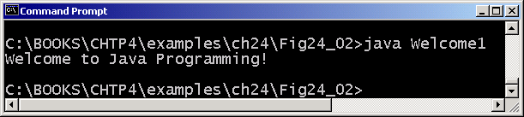
24.4 A Simple Program: Printing a Line of Text (VIII)
Figure 24.3 Executing the Welcome1 application in a Microsoft Windows MS-DOS Prompt

Slide 18
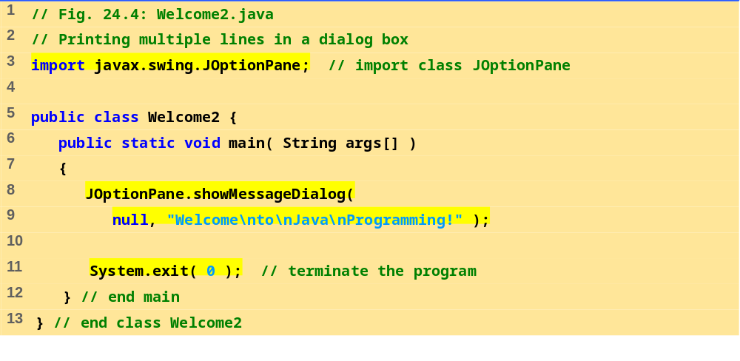
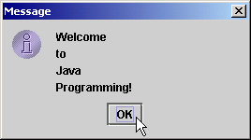
Welcome2.java
Program Output

Slide 19
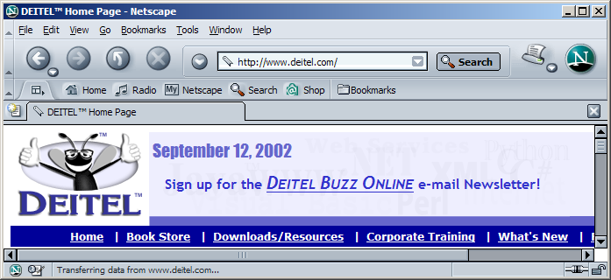
24.4 A Simple Program: Printing a Line of Text (IX)
Figure 24.5 A sample Netscape Navigator window with GUI components.
button
label
menu
menu bar
text field

Slide 20
24.4 A Simple Program: Printing a Line of Text (X)
Title bar
The dialog box is automatically sized to accommodate the string.
The OK button allows the user to dismiss the dialog box.
Mouse cursor

Slide 21
24.5 Another Java Application: Adding Integers
Variables
  Locations in memory that hold data
  Must be defined with name and data type before use
    Primitive data types (keywords): boolean, char, byte, short, int, long, float, double (details in Chapter 25)
    String (java.lang) - hold strings: "Hi" "37"
    int - holds integers: -1, 0, 15
  Name format - first letter lowercase, new word capitalized
    myVariable, myOtherVariable
  Definitions: specify name and type
    Can have multiple variables per definition
    int myInt, myInt2, myInt3;
    String myString, myString2;

Slide 22
24.5 Another Java Application: Adding Integers (II)
Method showInputDialog
  Of class JOptionPane
  Displays prompt (gets user input)
    Argument - Text to display in prompt
  Java does not have a simple form of input
    Nothing analogous to System.out.print
  Returns what user input
    Assign input to a variable using assignment operator =
  myString = JOptionPane.showInputDialog( "Enter an integer" );
    = has two operands (binary operator)
      Expression on right evaluated, assigned to variable on left

Slide 23
24.5 Another Java Application: Adding Integers (III)
Integer.parseInt
  static method of class Integer
  Input from showInputDialog a String
    Want to convert it into an integer
    parseInt takes a String, returns an integer
    myInt = Integer.parseInt( myString );
    Note assignment operator
The + operator
  String concatenation - "adding" strings
  "Hello" + " there " same as "Hello there"
  Print variables
    "myInt has a value of: " + myInt
  Used for addition, as in C / C ++:
    sum = int1 + int2;

Slide 24
24.5 Another Java Application: Adding Integers (III)
showOptionDialog
  Another version
  First argument: null
  Second: message to display
  Third: string to display in title bar
  Fourth: type of message to display
    JOptionPane.PLAIN_MESSAGE
    Other types in Fig. 24.7

Slide 25
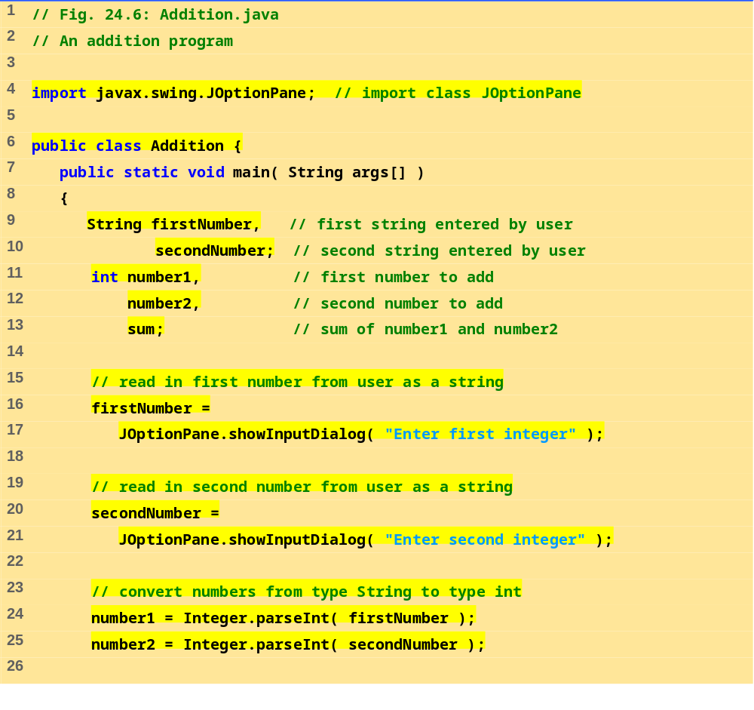
Addition.java (Part 1 of 2)

Slide 26
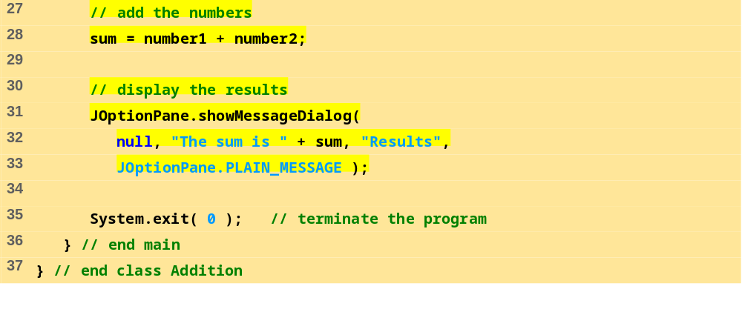
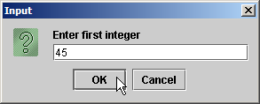
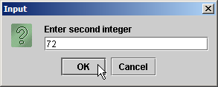
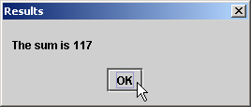
Addition.java (Part 2 of 2)

Slide 27
24.5 Another Java Application: Adding Integers (IV)
Argument 3: The title bar string
Argument 2: The
message to display
The user clicks OK to dismiss the dialog.

Slide 28
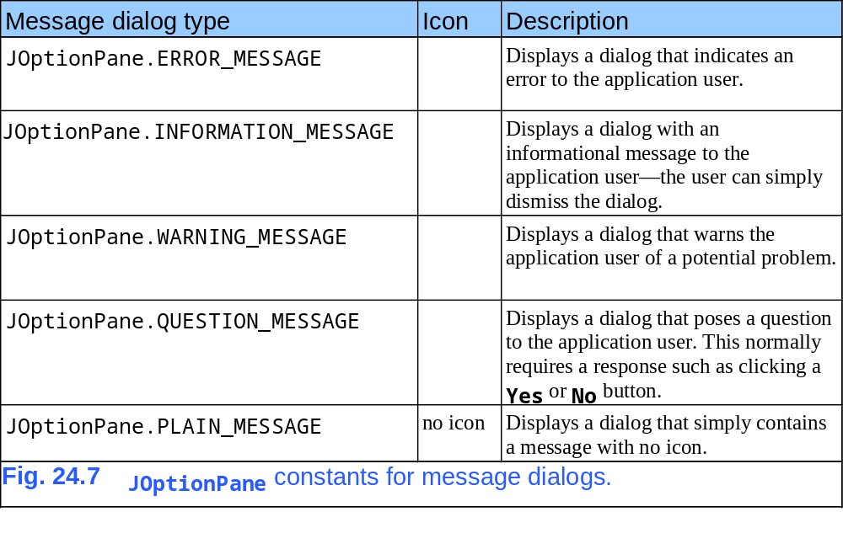



24.5 Another Java Application: Adding Integers (V)

Slide 29
24.6 Sample Applets from the Java 2 Software Development Kit
Applet
  Program that runs in
    appletviewer (test utility for applets)
    Web browser (IE, Communicator)
  Executes when HTML document containing applet is opened
Sample Applets
  Provided in Java 2 Software Development Kit (J2SDK)
  Source code included (.java files)
  Located in demo directory of J2SDK install

Slide 30
24.6 Sample Applets from the Java 2 Software Development Kit
Running applets
  In command prompt, change to subdirectory of applet
  cd directoryName
  There will be an HTML file used to execute applet
  type appletviewer example1.html
  Applet will run, Reload and Quit commands under Applet menu
Example applets
  Tic-Tac-Toe
  Drawing programs
  Animations
  See Fig. 24.8

Slide 31
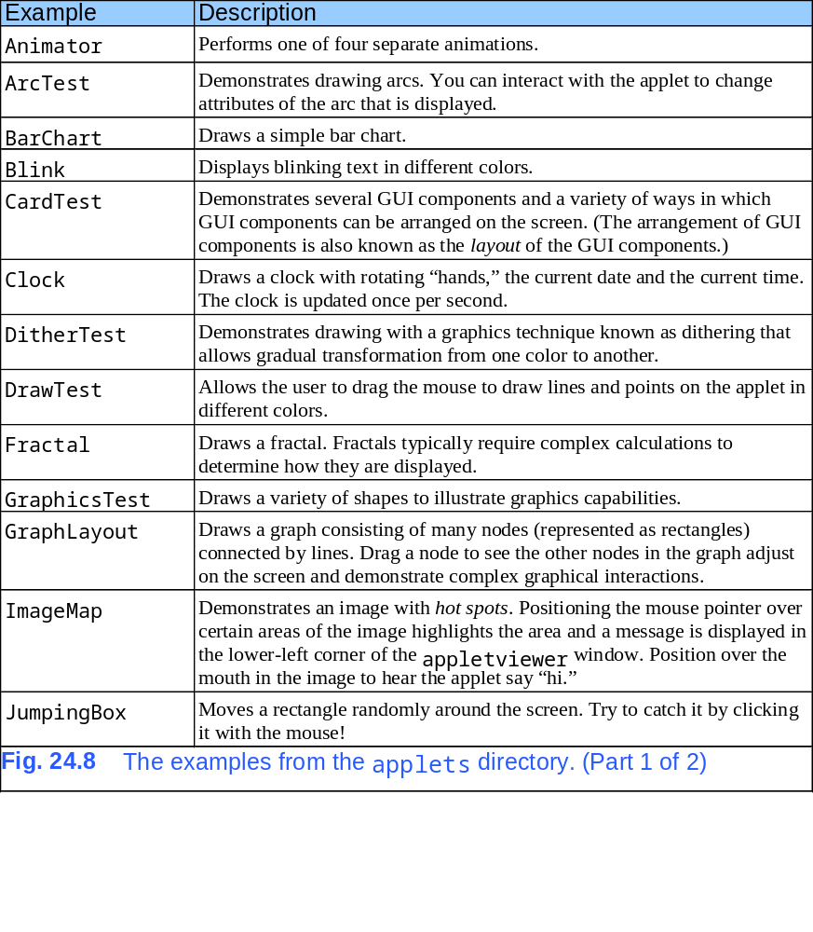
24.6 Sample Applets from the Java 2 Software Development Kit

Slide 32
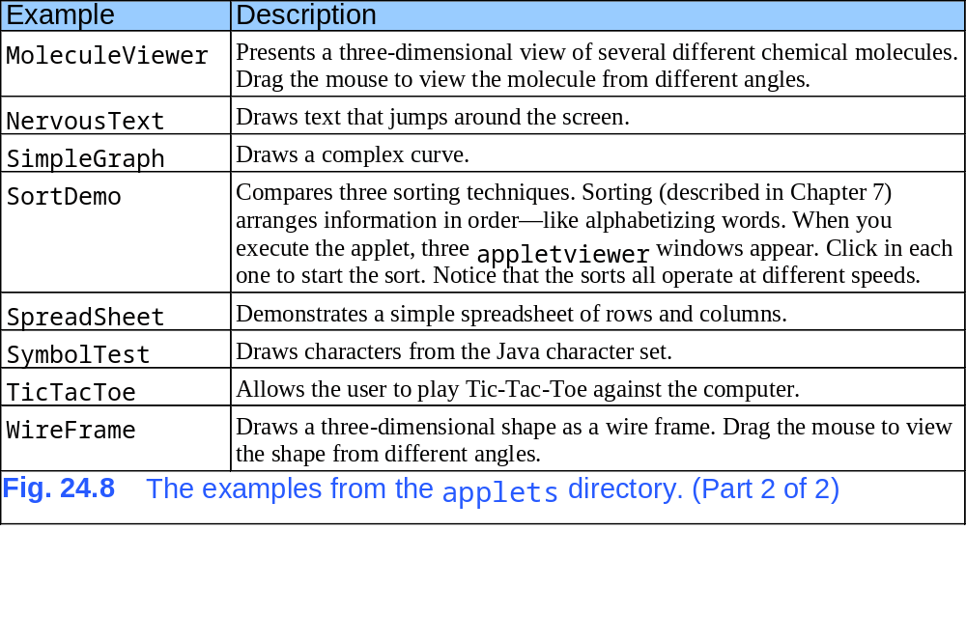
24.6 Sample Applets from the Java 2 Software Development Kit

Slide 33
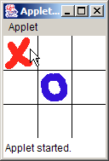
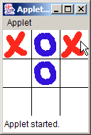
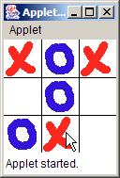
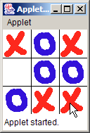
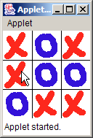
24.6 Sample Applets from the Java 2 Software Development Kit
Figure 24.9 Sample execution of the TicTacToe applet.

Slide 34
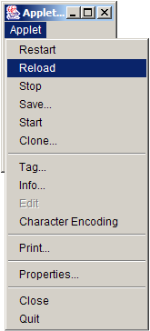
24.6 Sample Applets from the Java 2 Software Development Kit
Figure 24.10 Selecting Reload from the appletviewer’s Applet menu.
Reload the applet to execute it again.
Select Quit to terminate the appletviewer.

Slide 35
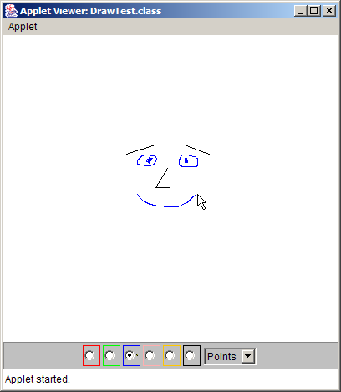
24.6 Sample Applets from the Java 2 Software Development Kit
Figure 24.11 Sample execution of the DrawTest applet.
Drag the mouse here to draw.
Select the drawing color by clicking the circle for the color you want. These GUI components are commonly known as radio buttons.
Select the shape to draw by clicking the down arrow, then clicking Lines or Points. This GUI component is commonly known as a combo box, choice or drop-down list.

Slide 36
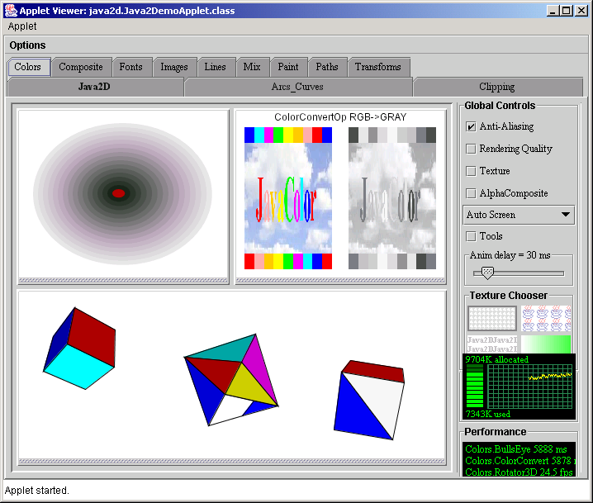
24.6 Sample Applets from the Java 2 Software Development Kit
Figure 24.12 Sample execution of the Java2D applet.

Slide 37
24.7 A Simple Java Applet: Drawing a String
Create our own applet
  Print "Welcome to Java Programming!"
  import javax.swing.JApplet
    Needed for all applets
  import java.awt.Graphics
    Allows program to draw graphics (lines, ovals, text) on an applet
  Like applications, applets have at least one class definition
Rarely create applets from scratch
  Use pieces of class existing definitions
  public class WelcomeApplet extends JApplet {
  extends ClassName - class to inherit from
    In this case, inherit from class JApplet

Slide 38
24.7 A Simple Java Applet: Drawing a String (II)
Inheritance
  JApplet is superclass (base class)
  WelcomeApplet is subclass (derived class)
  Derived class inherits data and methods of base class
    Can add new features to derived class
  Benefits
    Someone else has already defined what an applet is
      Applets require over 200 methods to be defined!
      By using inheritance, all those methods are now ours
    We do not need to know all the details of JApplet

Slide 39
24.7 A Simple Java Applet: Drawing a String (III)
Classes
  Templates/blueprints create or instantiate objects
    Objects - locations in memory to store data
    Implies that data and methods associated with object
Methods
  paint, init, and start called automatically for all applets
    Get "free" version when you inherit from JApplet
    By default, have empty bodies
    Must override them and define yourself

Slide 40
24.7 A Simple Java Applet: Drawing a String (IV)
Method paint
  Used to draw graphics, define:
  public void paint( Graphics g )
    Takes a Graphics object g as a parameter
    For now, all method definitions begin with public
  Call methods of object g to draw on applet
    drawString("String to draw", x, y);
    Draws "String to draw" at location (x,y)
      Coordinates specify bottom left corner of string
      (0, 0) is upper left corner of screen
      Measured in pixels (picture elements)

Slide 41
24.7 A Simple Java Applet: Drawing a String (IV)
Create the HTML file (.html or .htm)
  Many HTML codes (tags) come in pairs
    <myTag> ... </myTag>
  Create <HTML> tags with <applet> tags inside
  appletviewer only understands <applet> tags
    Minimal browser
    Specify complied .class file, width, and height of applet (in pixels)
    <applet code = "WelcomeApplet.class" width = 300
    height = 30>
    Close tag with </applet>
Running the applet
  appletviewer WelcomeApplet.html

Slide 42
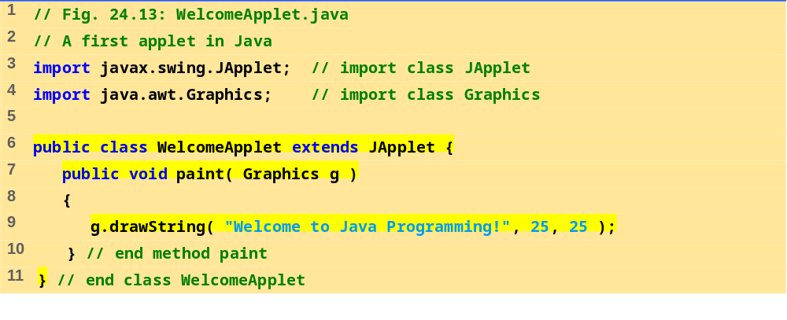
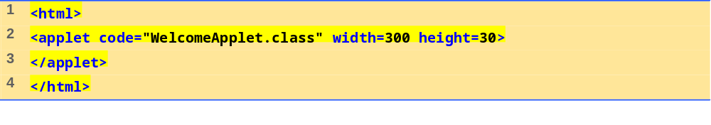

WelcomeApplet.java

Slide 43
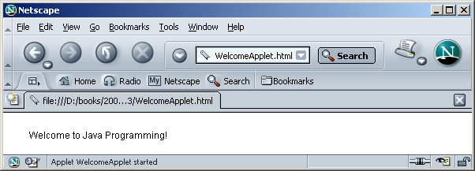
24.8 Two More Simple Applets: Drawing Strings and Lines

Slide 44
24.8 Two More Simple Applets: Drawing Strings and Lines
Other methods of class Graphics
  No concept of lines of text, as in System.out.println when drawing graphics
  To print multiple lines, use multiple drawString calls
  drawLine( x1, y2, x2, y2 ) ;
    Draws a line from ( x1, y1 ) to ( x2, y2 )

Slide 45
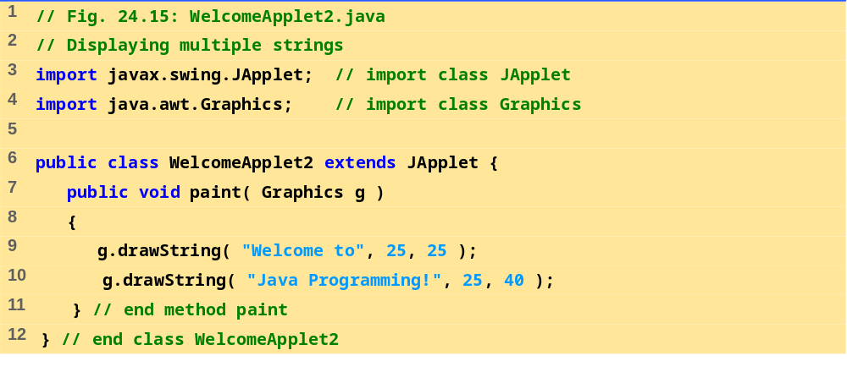
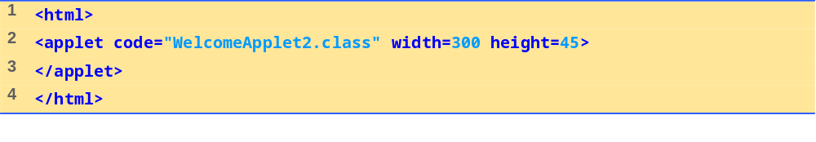
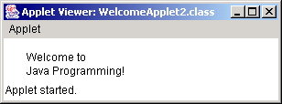
WelcomeApplet2.java
Program Output

Slide 46
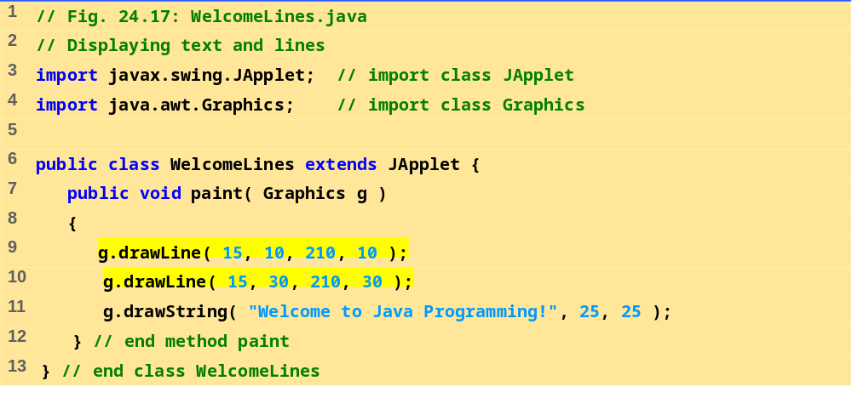
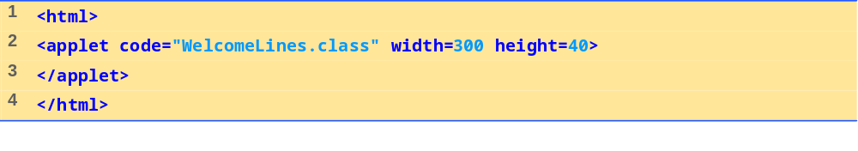
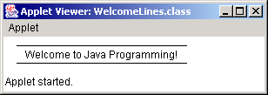
WelcomeLines.java
Program Output

Slide 47
24.9 Another Java Applet: Adding Integers
Next applet mimics program to add two integers
  This time, use floating point numbers
    Can have decimal point, 6.7602
    float - single precision floating point number (7 significant digits)
    double - approximately double precision floating point number (15 significant digits)
      Uses more memory
  Use showInputDialog to get input, as before
  Use Double.parseDouble( String )
    Converts a String to a double

Slide 48
24.9 Another Java Applet: Adding Integers (II)
import statements
  Not necessary if specify full class name every time needed
  public void paint( java.awt.Graphics g )
  * - indicates all classes in package should be available
    import java.swing.*;
      Recall that this contains JApplet and JOptionPane
    Does not import subdirectories
Instance variables
  Variables defined in body of a class (not in a method)
    Each object of class gets its own copy
    Can be used inside any method of the class
  Before, variables defined in main
    Local variables, known only in body of method defined

Slide 49
24.9 Another Java Applet: Adding Integers (III)
Instance variables
  Have default values
    Local variables do not, and require initialization before use
    Good practice to initialize instance variables anyway
Method init
  Called automatically in all applets
  Commonly used to initialize variables
  public void init()
References
  Identifiers (such as myString) refer to objects
    Contain locations in memory
  References used to call methods, i.e. g.drawString

Slide 50
24.9 Another Java Applet: Adding Integers (III)
Variables vs. Objects
  Variables
    Defined by a primitive data type
    char, byte, short, int, long, float, double, boolean
    Store one value at a time
    Variable myInt
  Objects defined in classes
    Can contain primitive (built-in) data types
    Can contain methods
    Graphics object g
  If data type a class name, then identifier is a reference
    Otherwise, identifier is a variable

Slide 51
24.9 Another Java Applet: Adding Integers (IV)
Other methods of class Graphics
  drawRect( x1, y1, x2, y2 );
  Draws a rectangle with upper-left corner ( x1, y1 ), and lower right corner (x2, y2 )

Slide 52
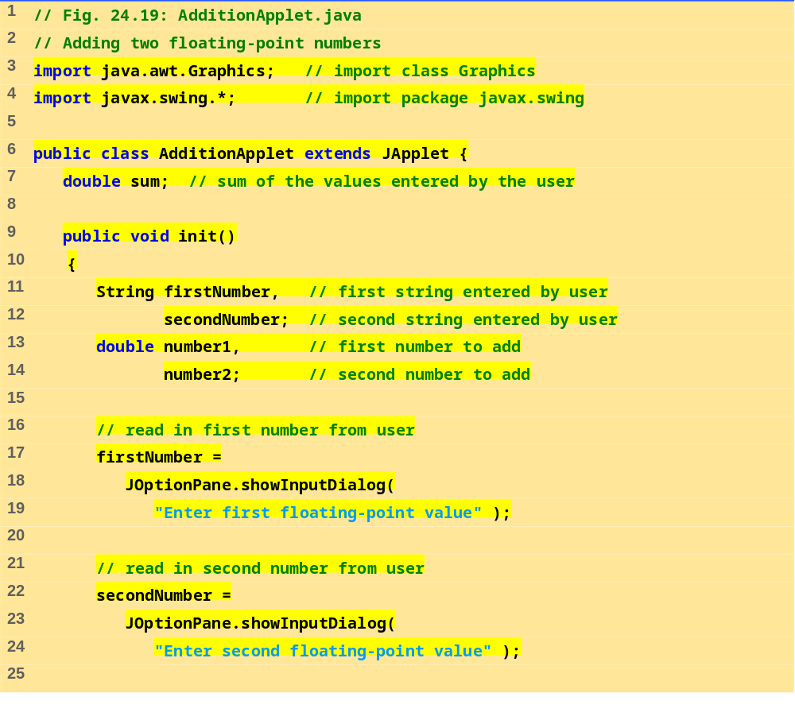
AdditionApplet.java (Part 1 of 2)

Slide 53
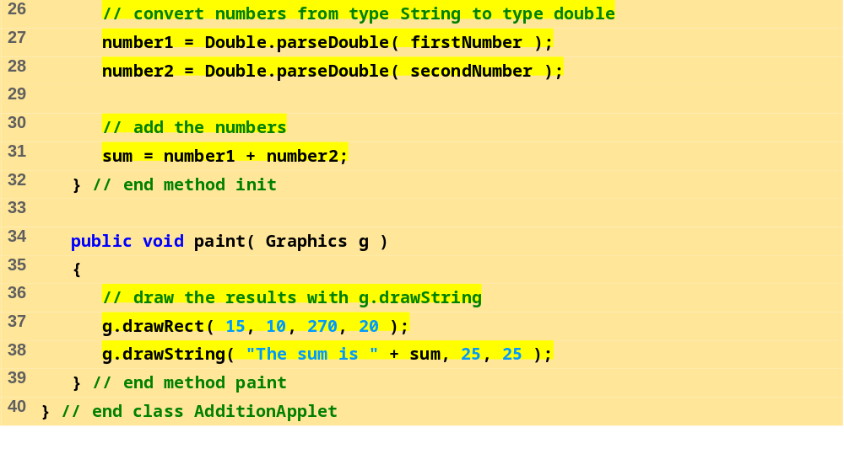
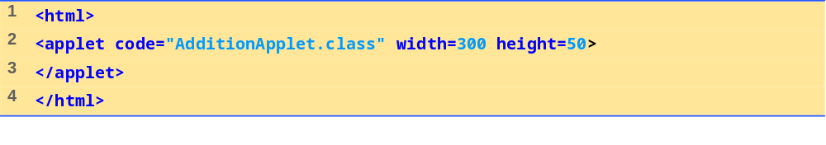
AdditionApplet.java (Part 2 of 2)

Slide 54
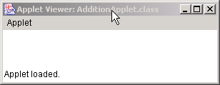
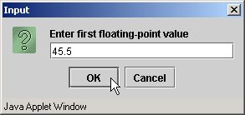
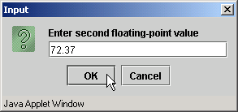
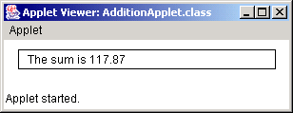
Program Output

